Slide 1
Node and HTTP

Slide 2
Objectives
Understand the Networking Essentials
Create and implement a simple HTTP server using the Node HTTP core module
Create and implement a web server to serve static HTML files from a folder

Slide 3
Networking Essentials

Slide 4
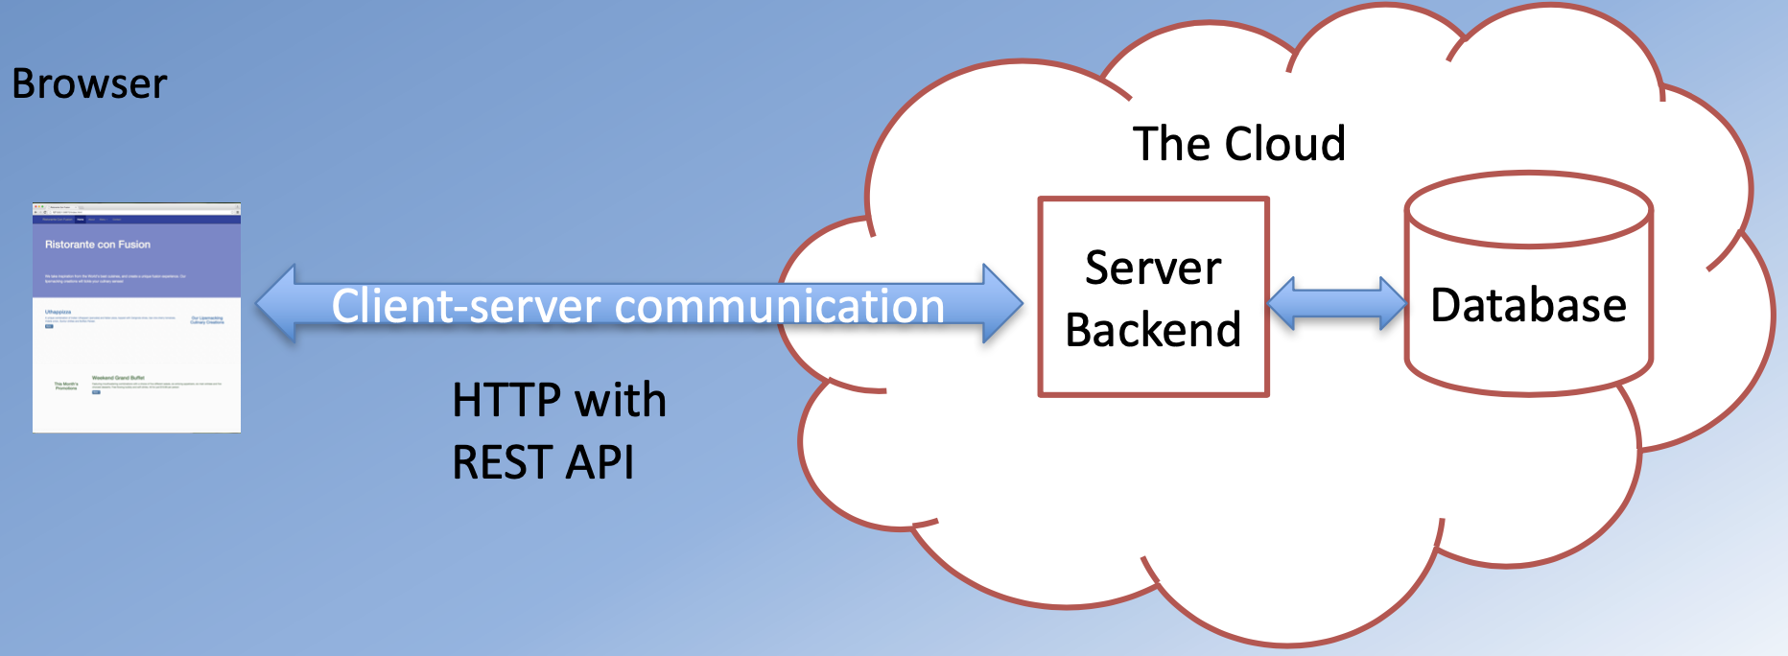
Client and Server
Web applications are not stand-alone
Many of them have a “Cloud” backend

Slide 5
Client-Server Communication
Network operations cause unexpected delays
You need to write applications recognizing the asynchronous nature of communication
Data is not instantaneously available

Slide 6
Hypertext Transfer Protocol (HTTP)
A client-server communications protocol
Allows retrieving inter- linked text documents (hypertext)
World Wide Web.
HTTP Verbs – HEAD
GET
POST
PUT
DELETE
TRACE
OPTIONS – CONNECT

Slide 7
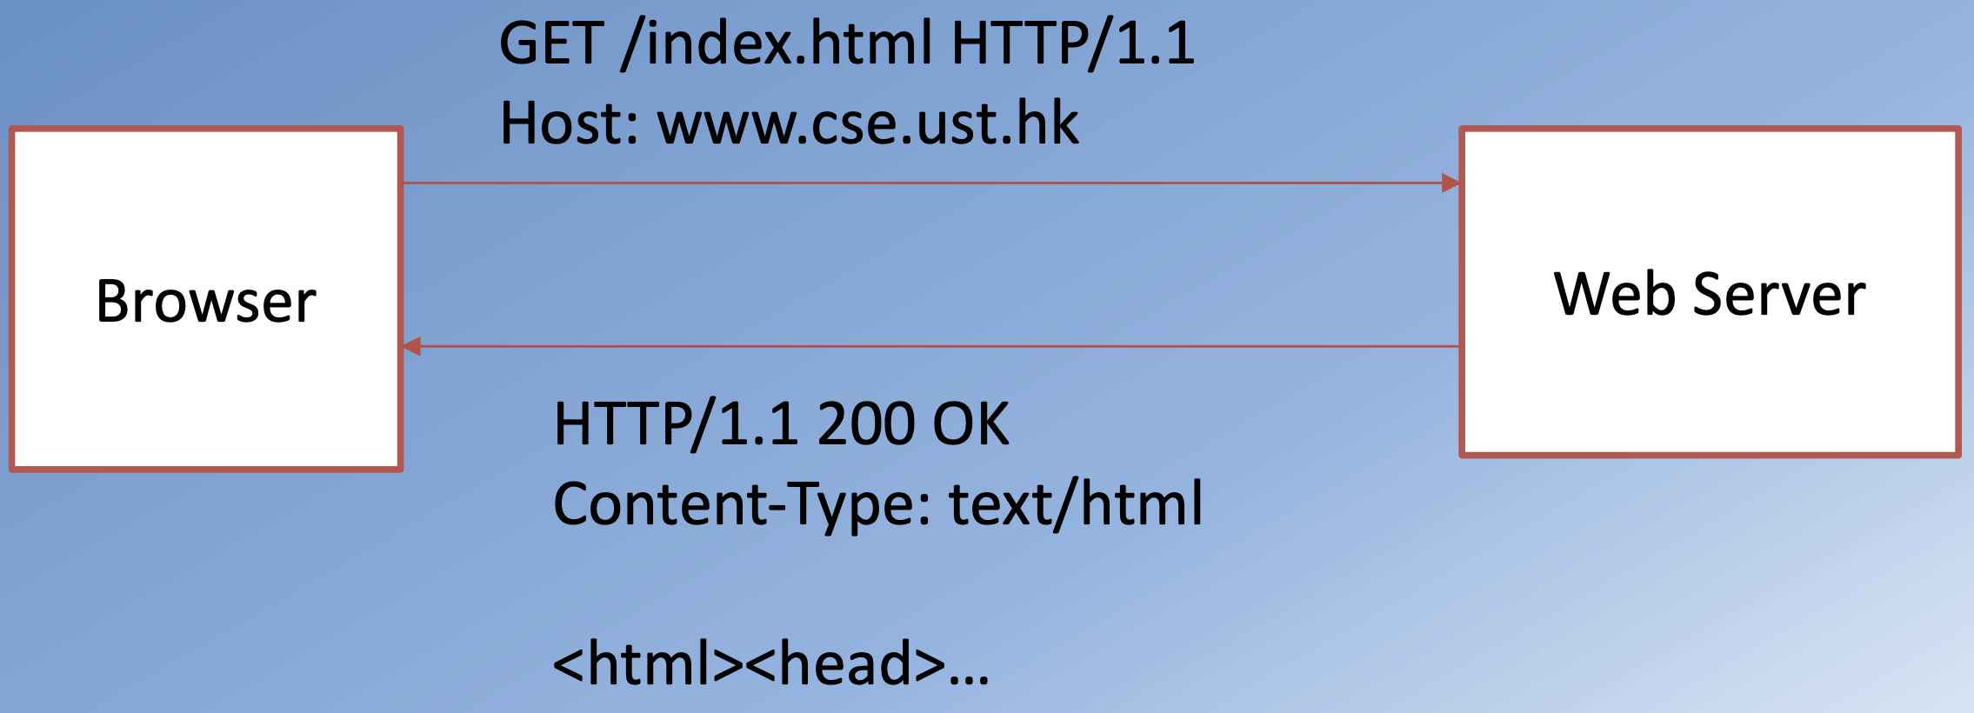
Hypertext Transfer Protocol (HTTP)

Slide 8
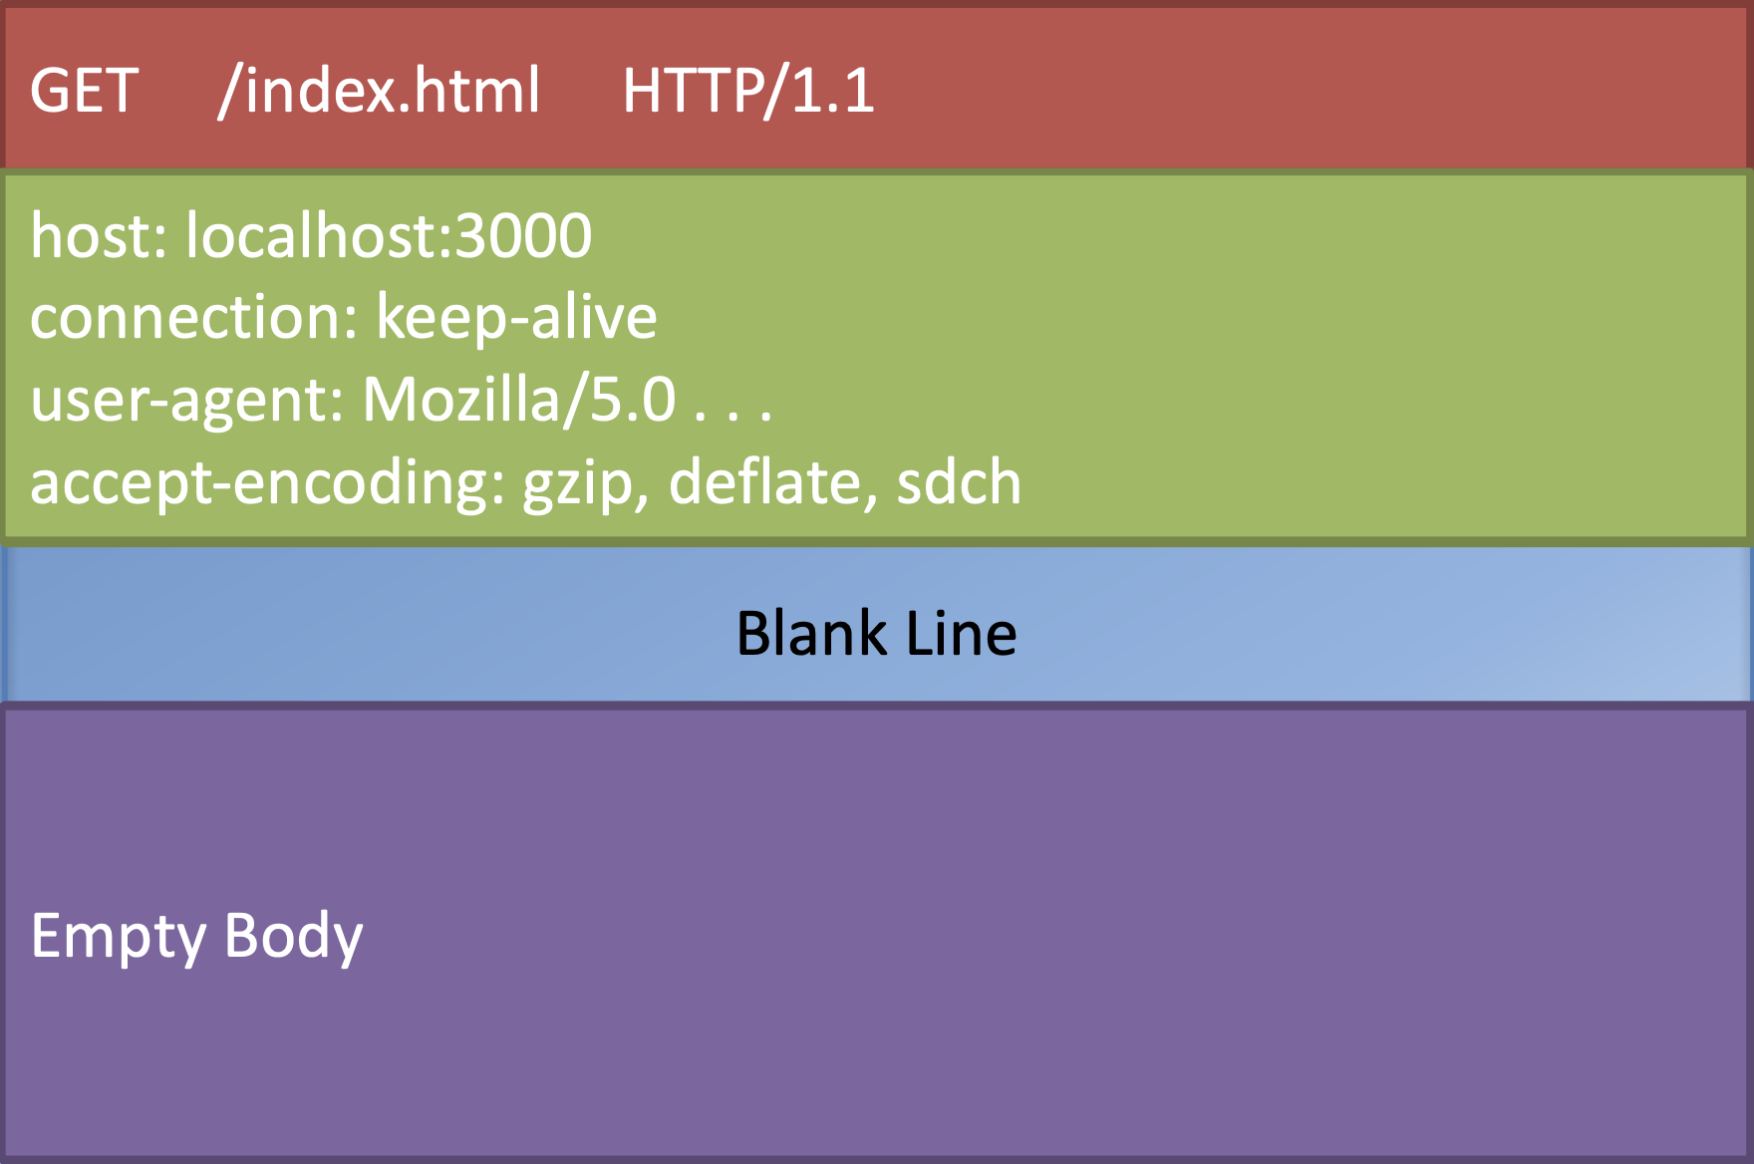
HTTP Request Message

Slide 9
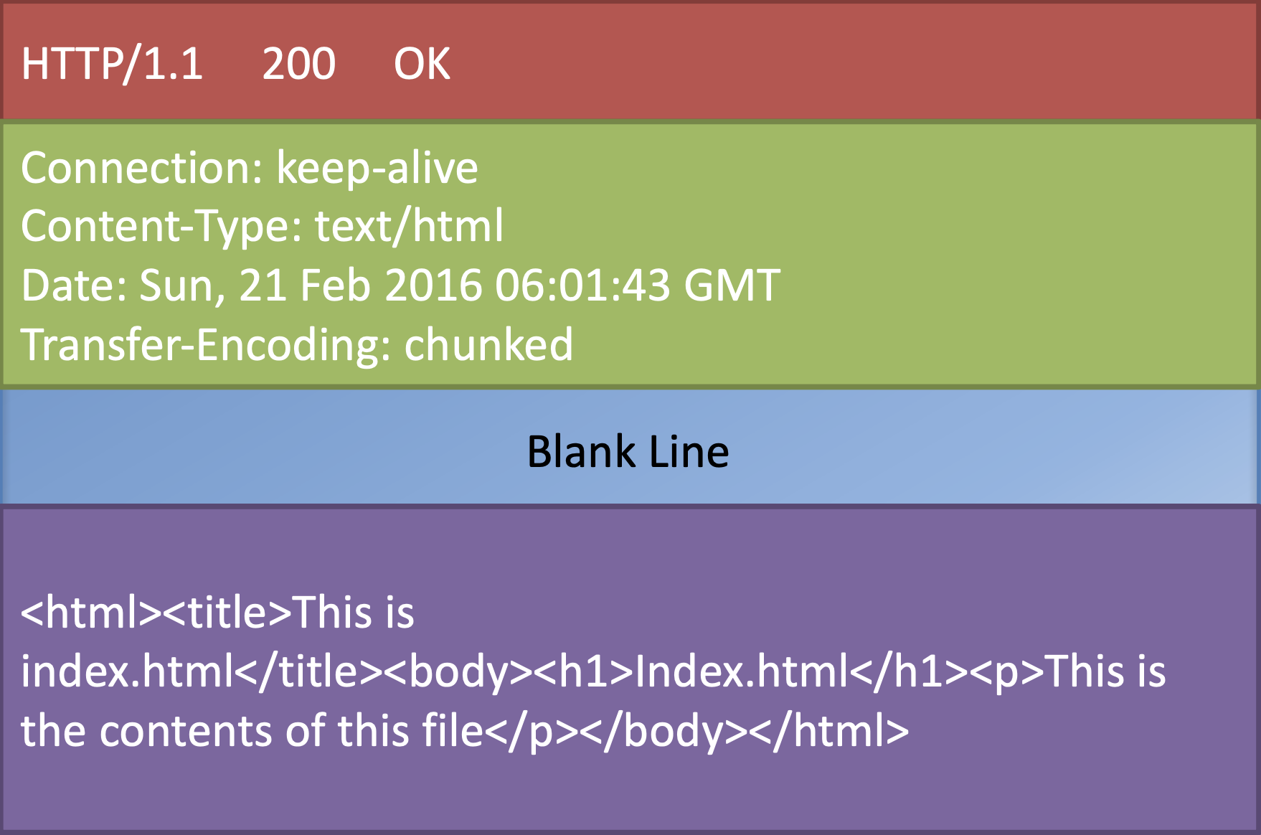
HTTP Response Message

Slide 10
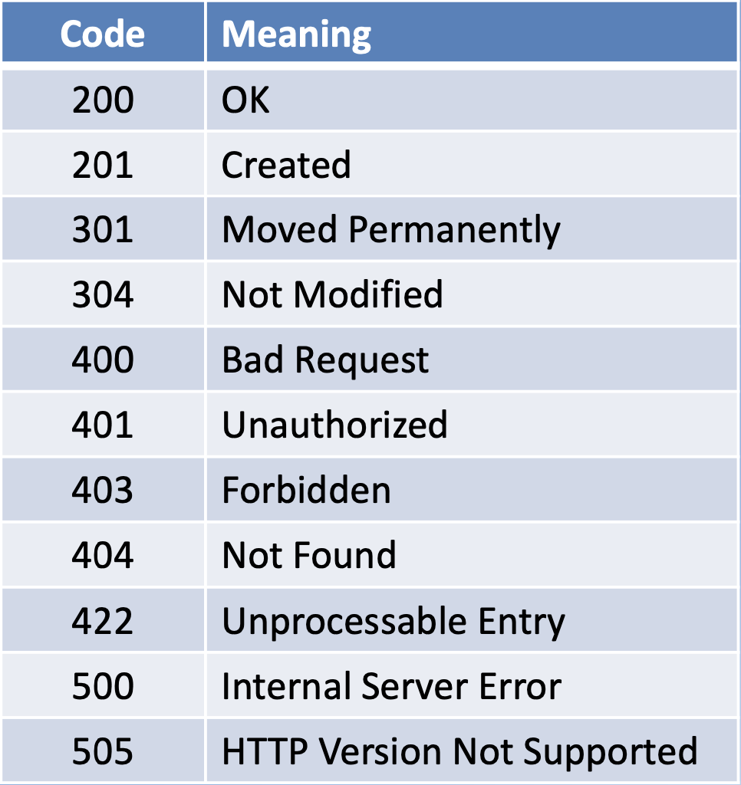
HTTP Response Codes (Main ones)
HTTP Response
Server may send back data in a specific format:
eXtensible Markup Language (XML) – Javascript Object Notation (JSON)

Slide 11
Javascript Object Notation (JSON)
http://www.json.org
Lightweight data interchange format
Language independent *
Self-describing and easy to understand
Data structured as:
A collection of
name/value pairs: Ordered list of values
Example { "promotions": [
{ "id": 0, "name": "Weekend Grand Buffet", "image": "images/buffet.png", "label": "New", "price": "19.99", "description": "Featuring mouthwatering combinations . . . "
} ]
}

Slide 12
Node HTTP module

Slide 13
Node HTTP module
Core networking module supporting a high-performance foundation for a HTTP stack
Using the module: const http = require('http');
Creating a server: const server = http.createServer(function(req, res){ . . . });
Starting the server: server.listen(port, . . . );

Slide 14
Node HTTP module
Incoming request message information available through the first parameter “req”
req.headers, req.body,...
Response message is constructed on the second parameter “res”
res.setHeader(“Content-Type”,“text/html”);
res.statusCode=200;
res.write(‘HelloWorld!’);
res.end(‘<html><body><h1>HelloWorld</h1></body></html>’);

Slide 15
Node path Module
Using path Module: const path = require(‘path’);
Some example path methods:
path.resolve(‘./public’+fileUrl);
path.extname(filePath);

Slide 16
Node fs Module
Use fs module in your application
const fs = require(‘fs’);
Some example fs methods:
fs.exists(filePath, function(exists) { . . . } ); fs.createReadStream(filePath).pipe(res);

Slide 17
Implement a simple HTTP Server

Slide 18
A Simple HTTP Server
Create a folder named node-http in the NodeJS folder and move into the folder.
In the node-http folder, create a subfolder named public.
At the prompt, type the following to initialize a package.json file in the node-http folder:
npm init

Slide 19
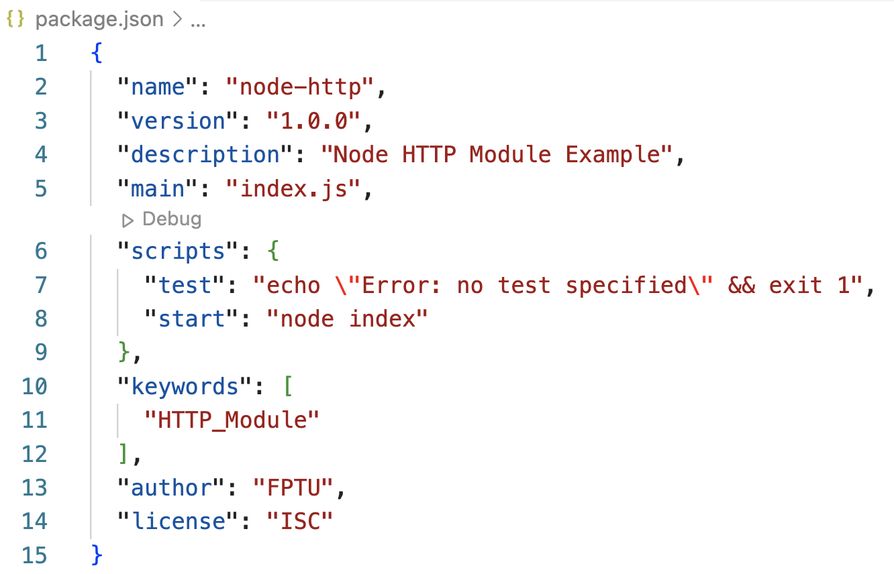
A Simple HTTP Server
Accept the standard defaults suggested until you end up with a package.json file containing the following:

Slide 20
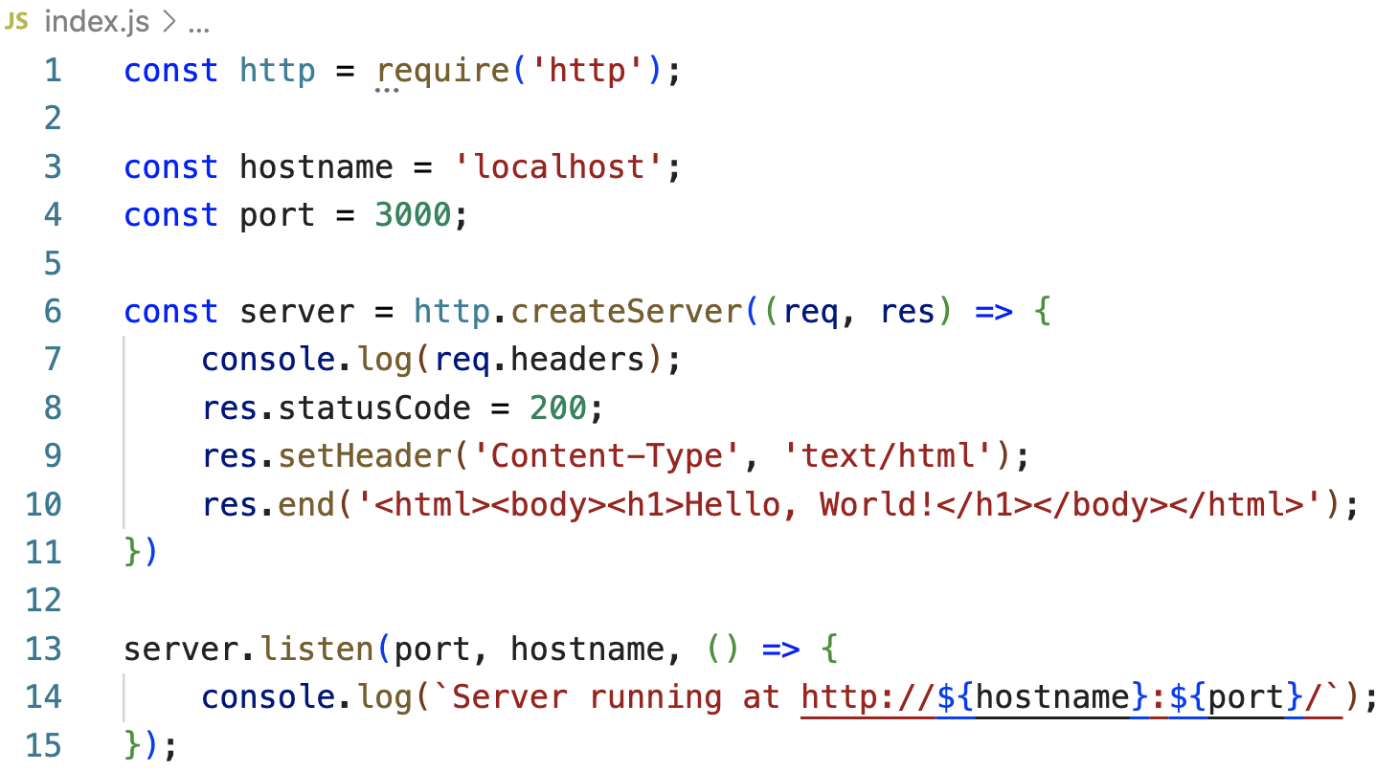
A Simple HTTP Server
Create a file named index.js and add the following code to it:

Slide 21
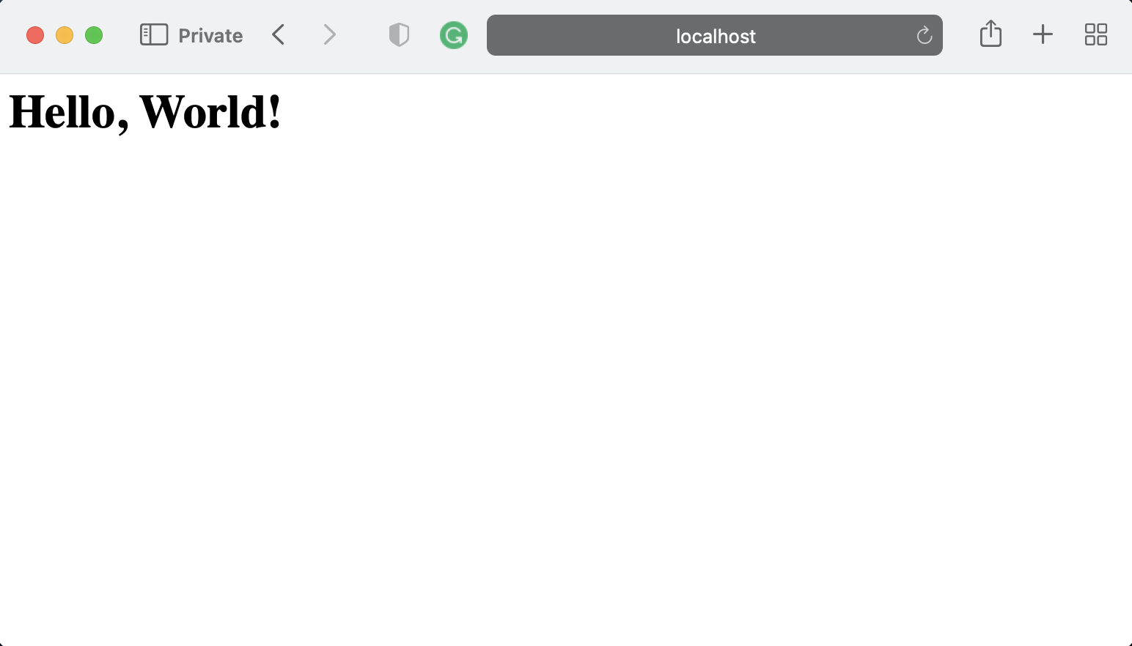
A Simple HTTP Server
Start the server by typing the following at the prompt:
Then you can type http://localhost:3000 in your browser address bar and see the result.
npm start
Notes:
You can also use postman chrome extension to send requests to the server and see the response. Alternately, you can download the stand-alone Postman tool from http://getpostman.com and install it on your computer

Slide 22
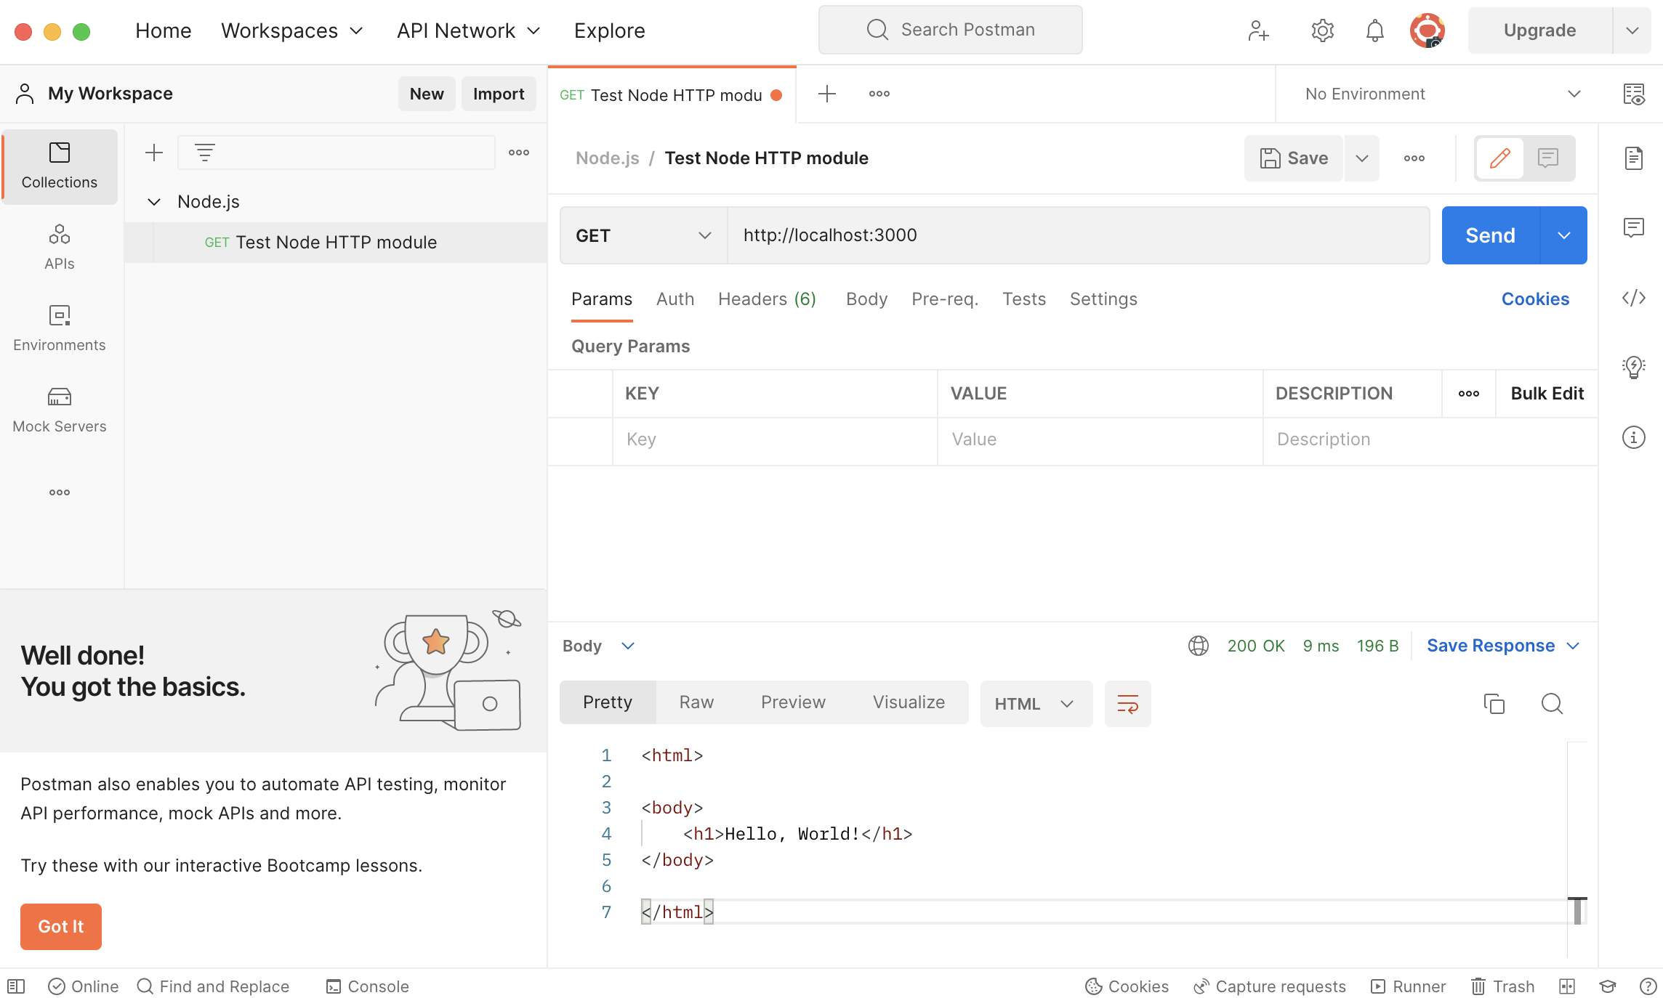
Using Postman to test HTTP Server

Slide 23
Implement a server that returns html files from a folder

Slide 24
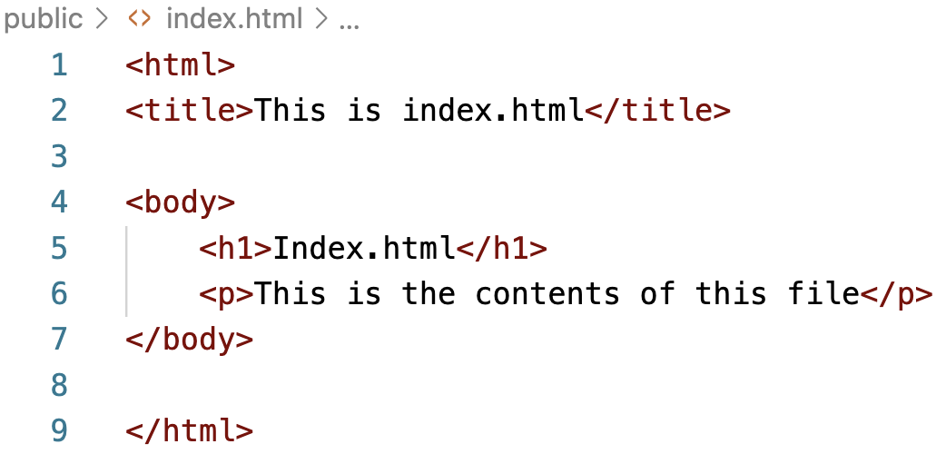
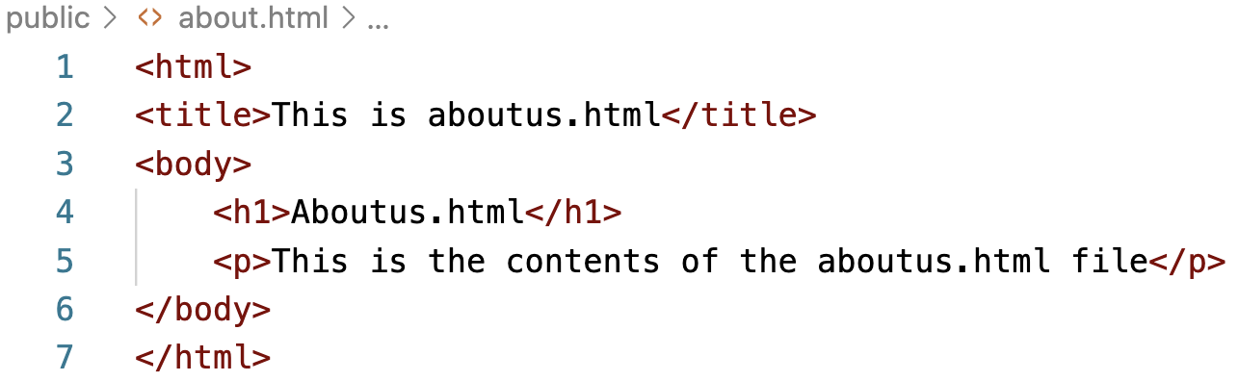
Serving HTML Files
In the public folder, create a file named index.html and add the following code to it:
Similarly create an aboutus.html file and add the following code to it:

Slide 25
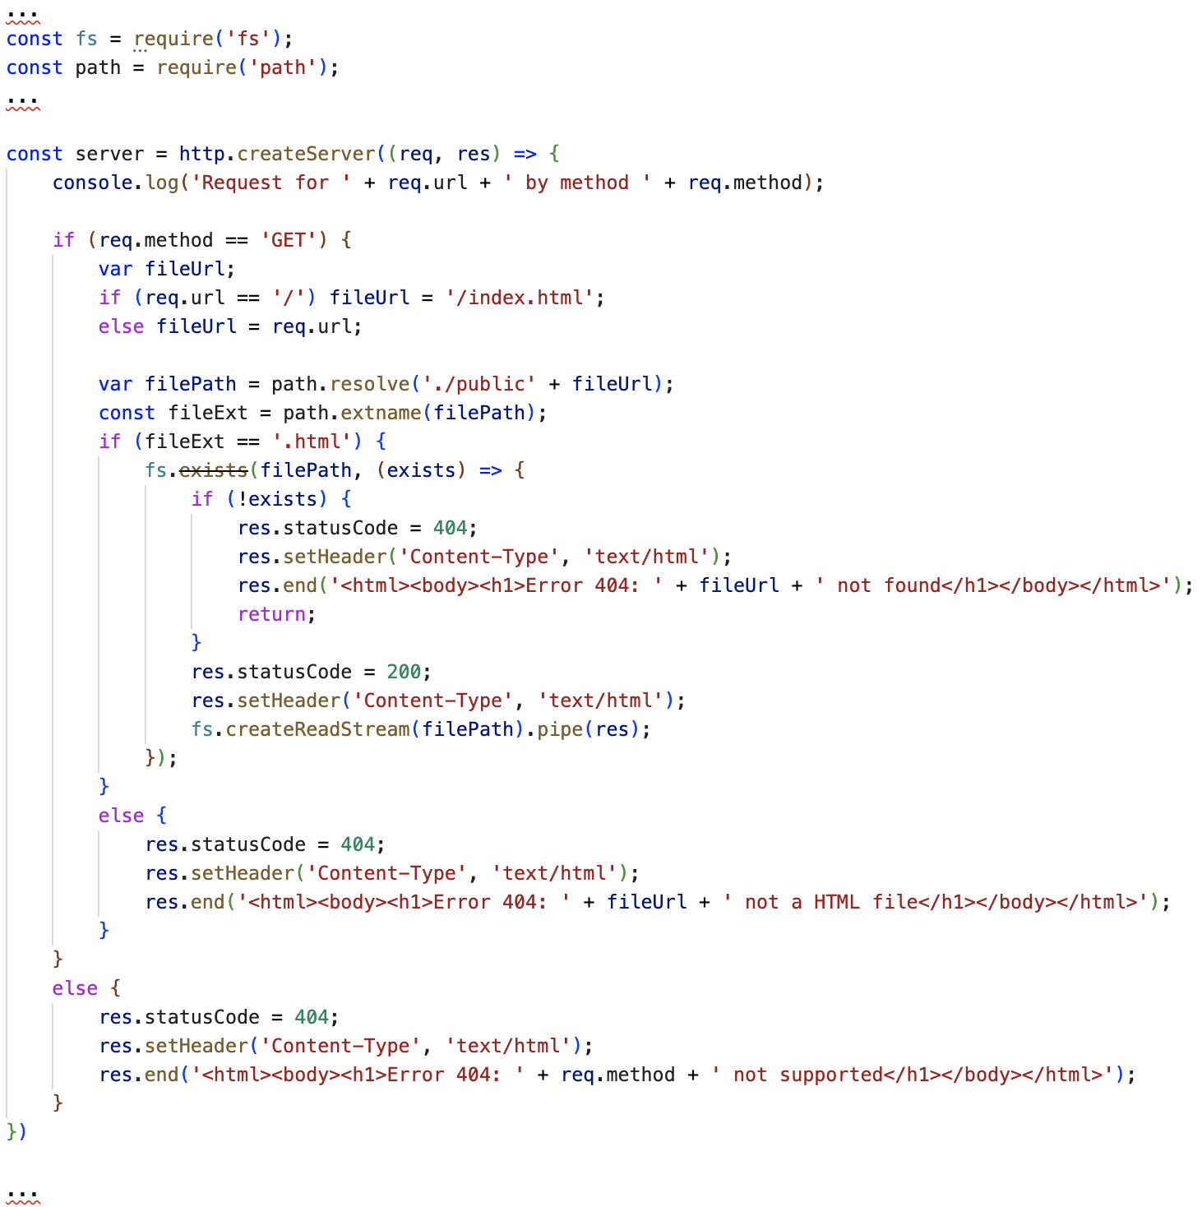
Serving HTML Files
Then update index.js as follows:

Slide 26
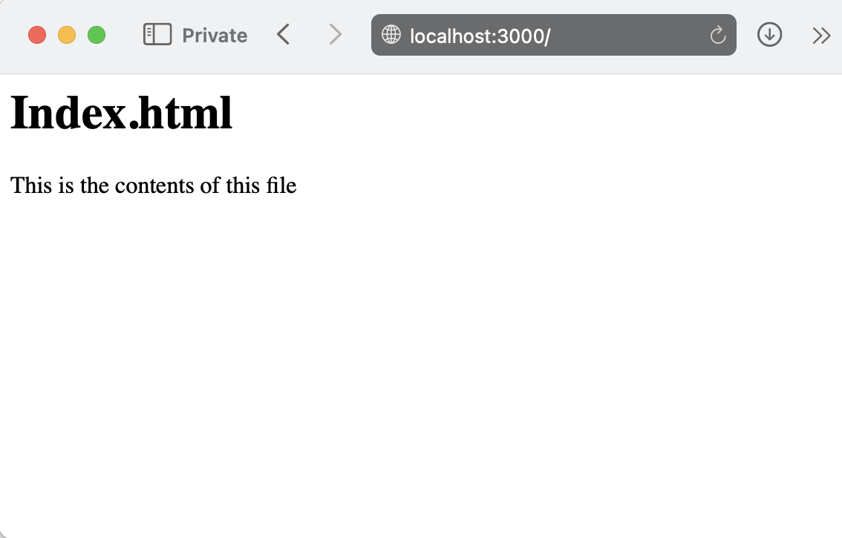
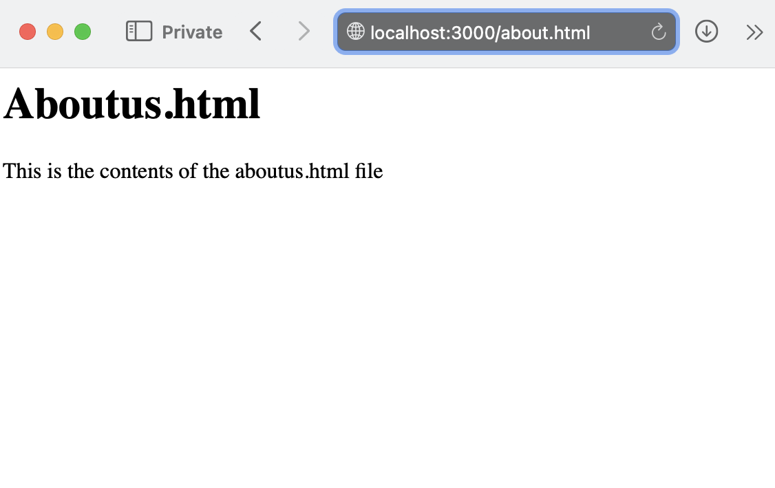
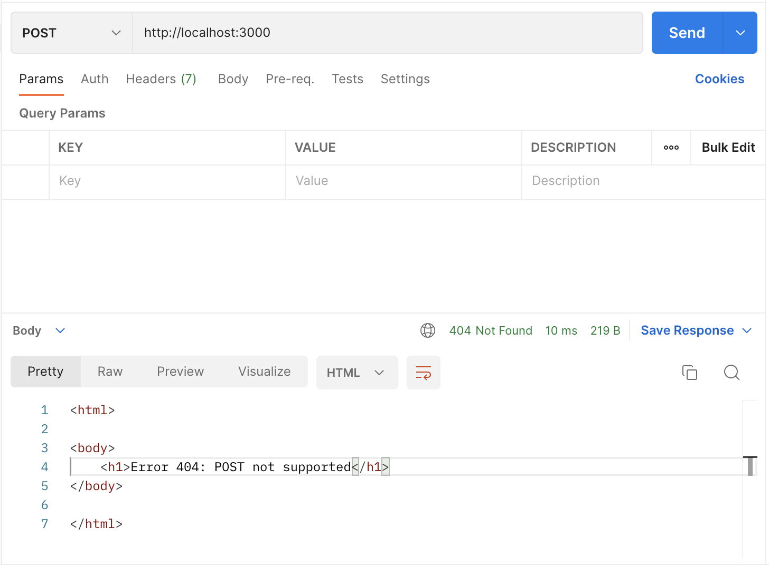
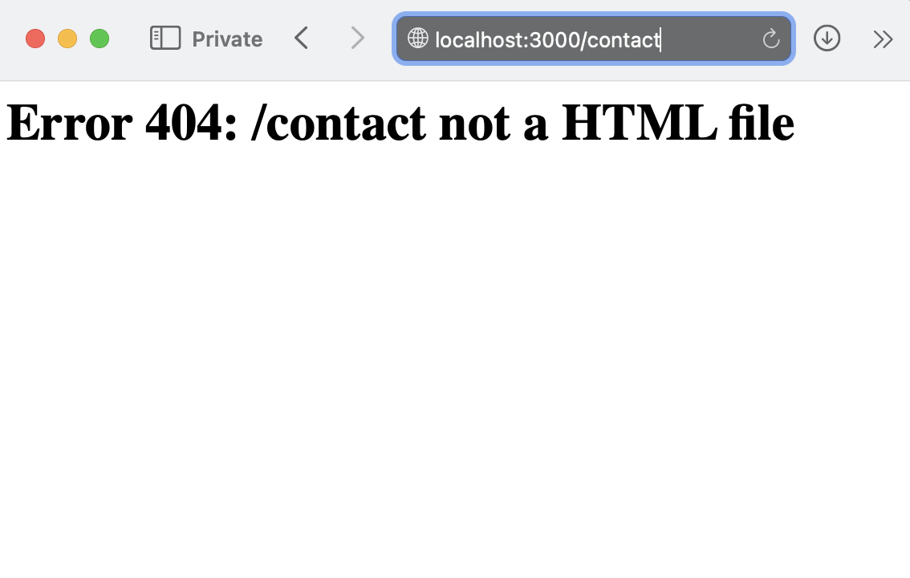
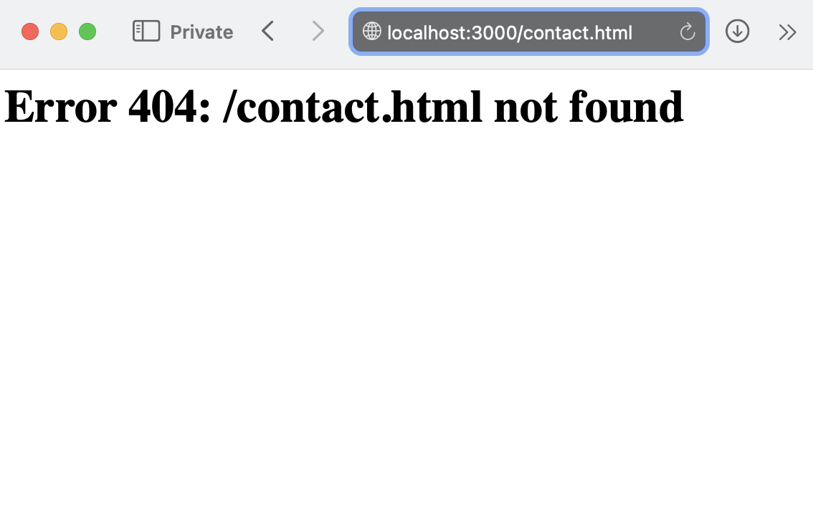
Start the HTTP Server

Slide 27
Summary
Understand the Networking Essentials
Step by step to implement a simple HTTP Server
Step by step to implement a server that returns html files from a folder

